Slide 1
SafeHire – An AI-Powered Service Hiring Platform
CSE299
Afridur Rahman Khan Mim | Nazia Faruque Diya

Slide 2
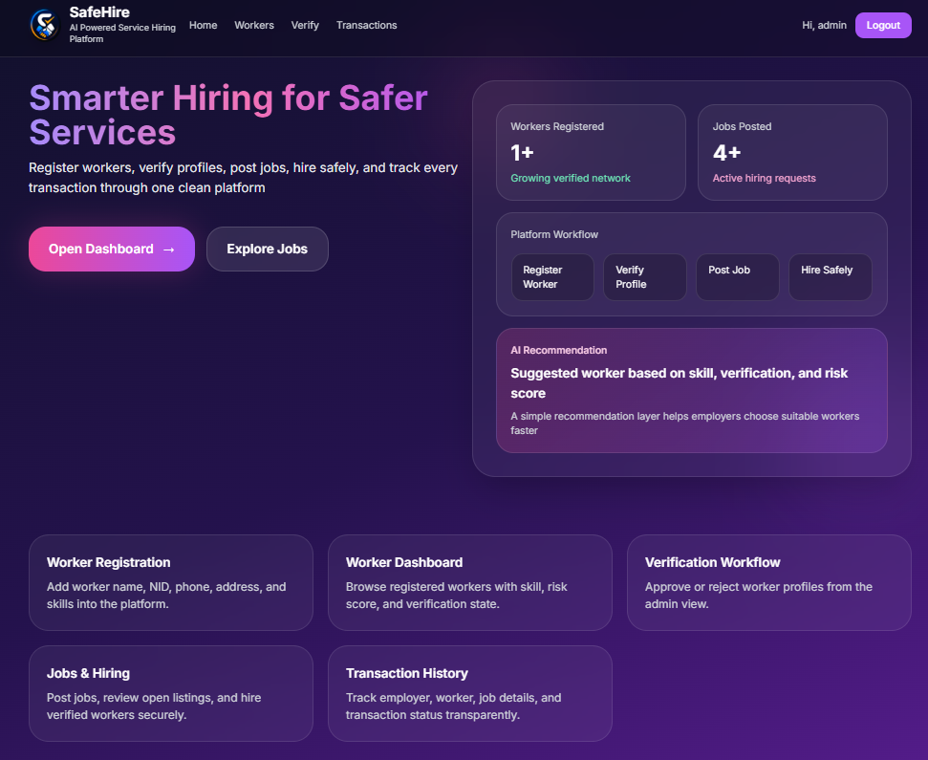
Project Overview
SafeHire is a web-based platform to connect employers with verified workers Focus on trust, safety, and smart hiring Includes: Worker verification system AI-based job matching Hiring & transaction system.
Afridur Rahman Khan Mim | Nazia Faruque Diya

Slide 3
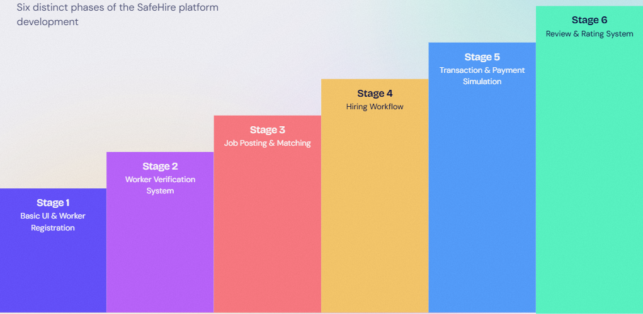
Development Stages Overview
Stage 1: Basic UI & Worker Registration
Stage 2: Worker Verification System
Stage 3: Job Posting & Matching
Stage 4: Hiring Workflow
Stage 5: Transaction & Payment Simulation
Stage 6: Review & Rating System
Afridur Rahman Khan Mim | Nazia Faruque Diya

Slide 4
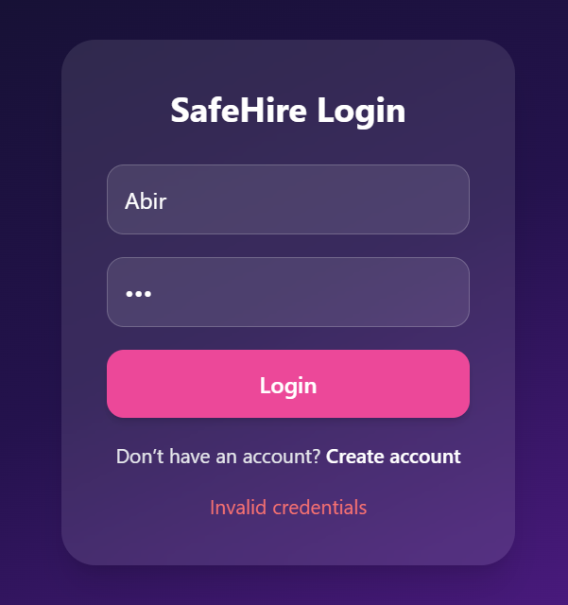
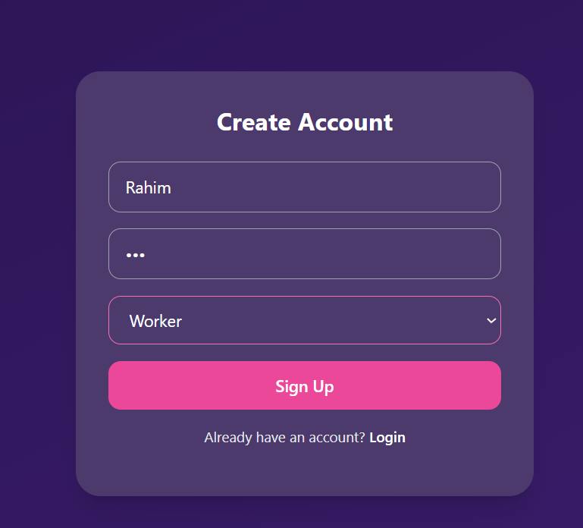
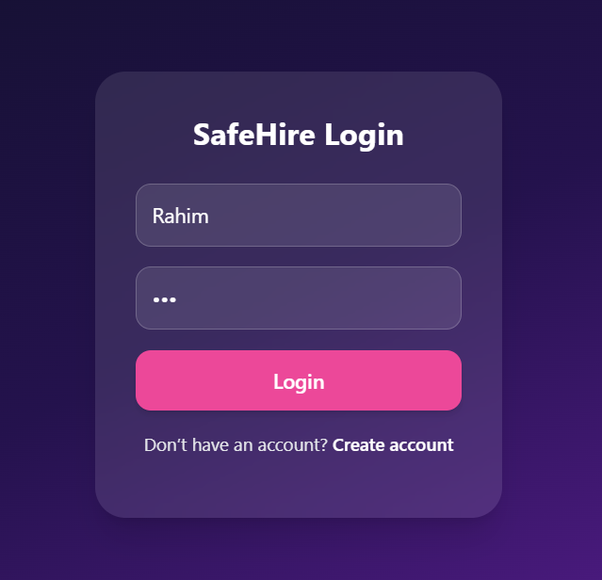
Worker Login System
Workers can securely log into the platform Authentication using username & password Role-based login (Worker / Employer) Redirects to dashboard after successful login.
Afridur Rahman Khan Mim | Nazia Faruque Diya

Slide 5
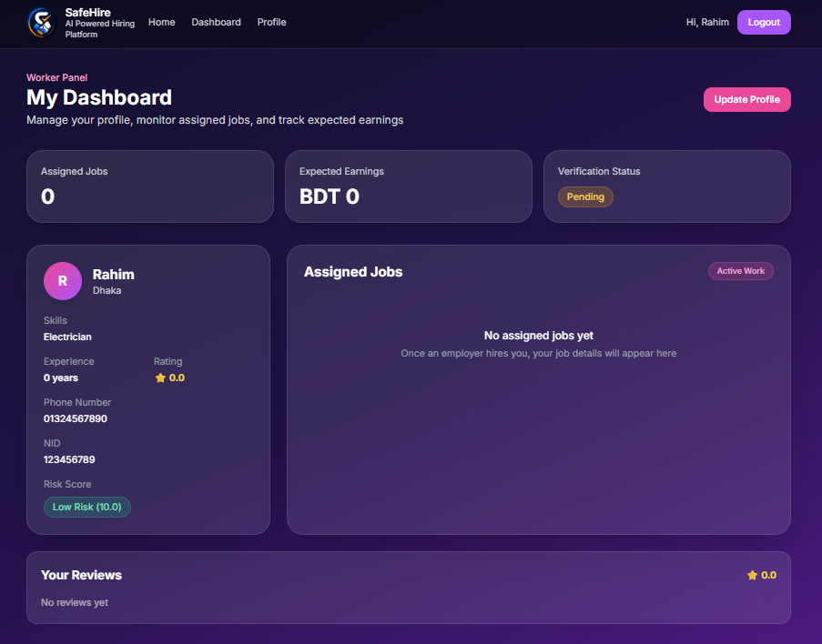
Worker Dashboard
Central interface for workers after login Displays: Assigned jobs
Job status (Open / Assigned / Completed)
Workers can: View job details , Track progress
User-friendly and responsive design
Afridur Rahman Khan Mim | Nazia Faruque Diya

Slide 6
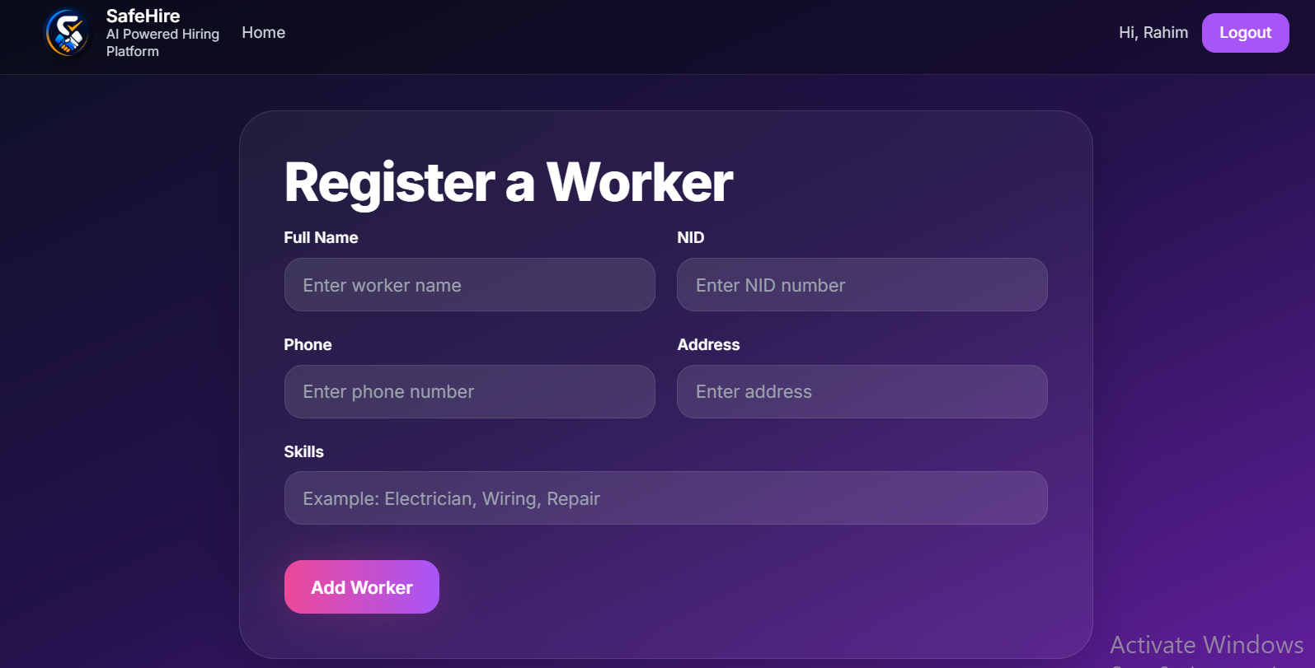
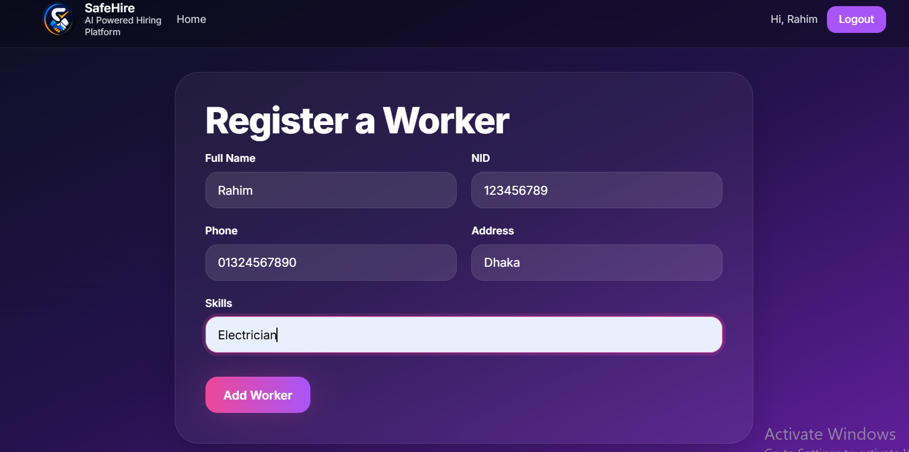
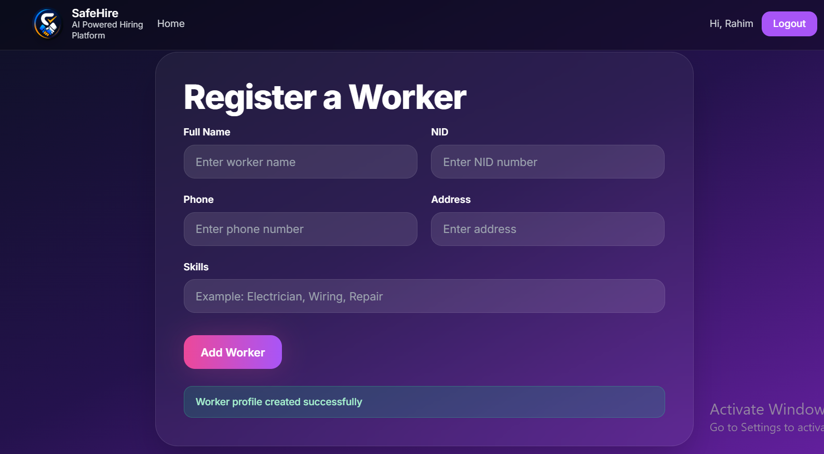
Stage 1 – Worker Registration System
Workers can register with: Name, Skills, NID
Backend stores worker data using database
Duplicate NID prevention implemented

Slide 7
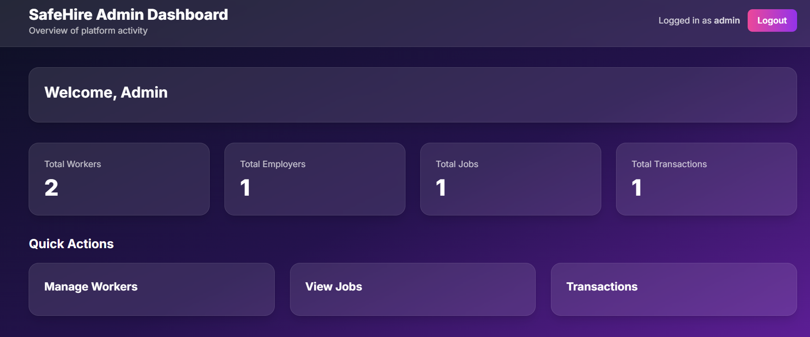
Admin Dashboard
The Admin Dashboard is the central control panel of the SafeHire system. It allows administrators to monitor platform activities, manage users, and ensure system integrity.
Key Features :
User Management :
View and manage all registered workers and employers
Worker Verification System:
Approve or reject worker profiles based on submitted information.
Job Monitoring
Track all posted jobs and their current status (Open, Assigned, Completed)
Transaction Management
Monitor all hiring transactions and payment status.
Review & Rating Oversight
View feedback given to workers to maintain service quality

Slide 8
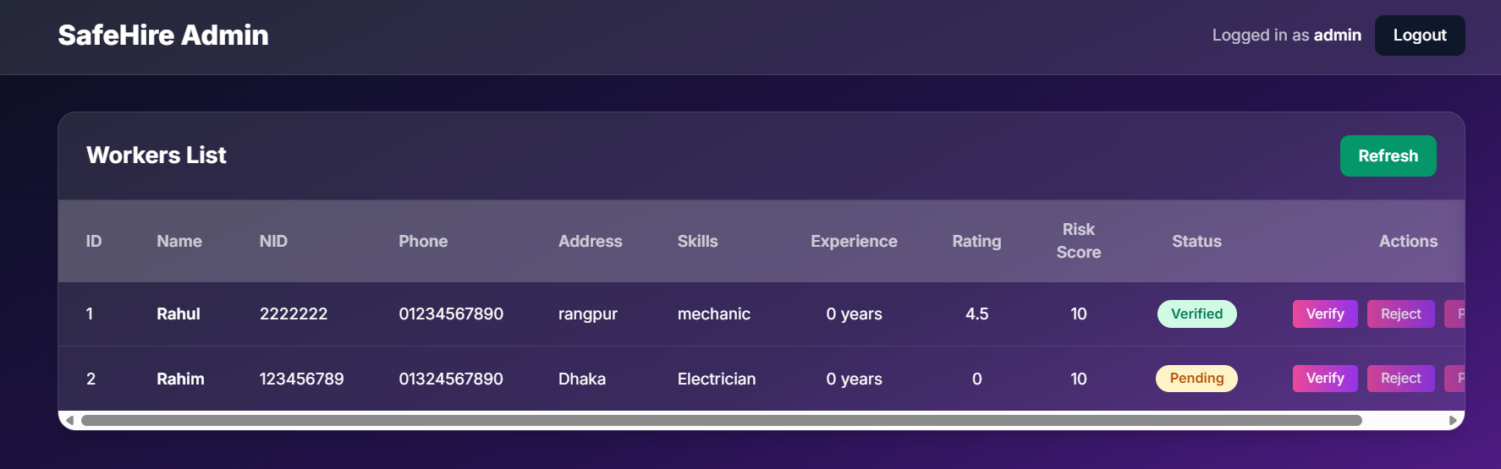
Stage 2 – Worker Verification System
Admin verifies workers: Pending → Verified / Rejected Improves platform trust Status badge system implemented

Slide 9
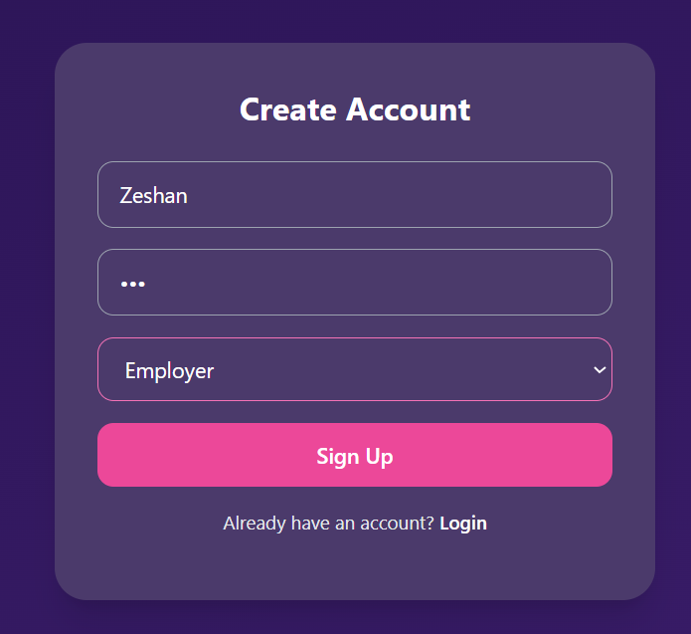
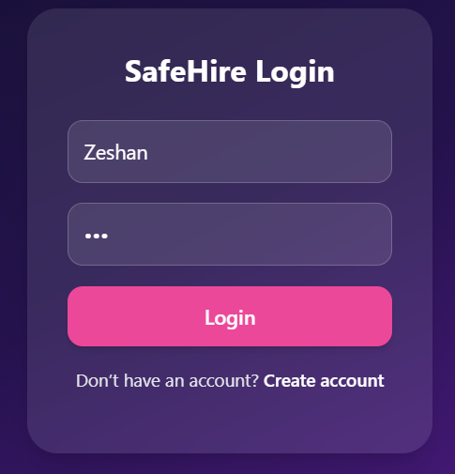
Employer Sign Up
The Employer Sign Up allows users to create an account to post jobs and hire workers on the SafeHire platform.
Key Features:
Registration Form
Employers enter username and password to create an account.
Secure Authentication
User credentials are stored securely in the database.
Quick Access Setup.
Simple and fast registration process.

Slide 10
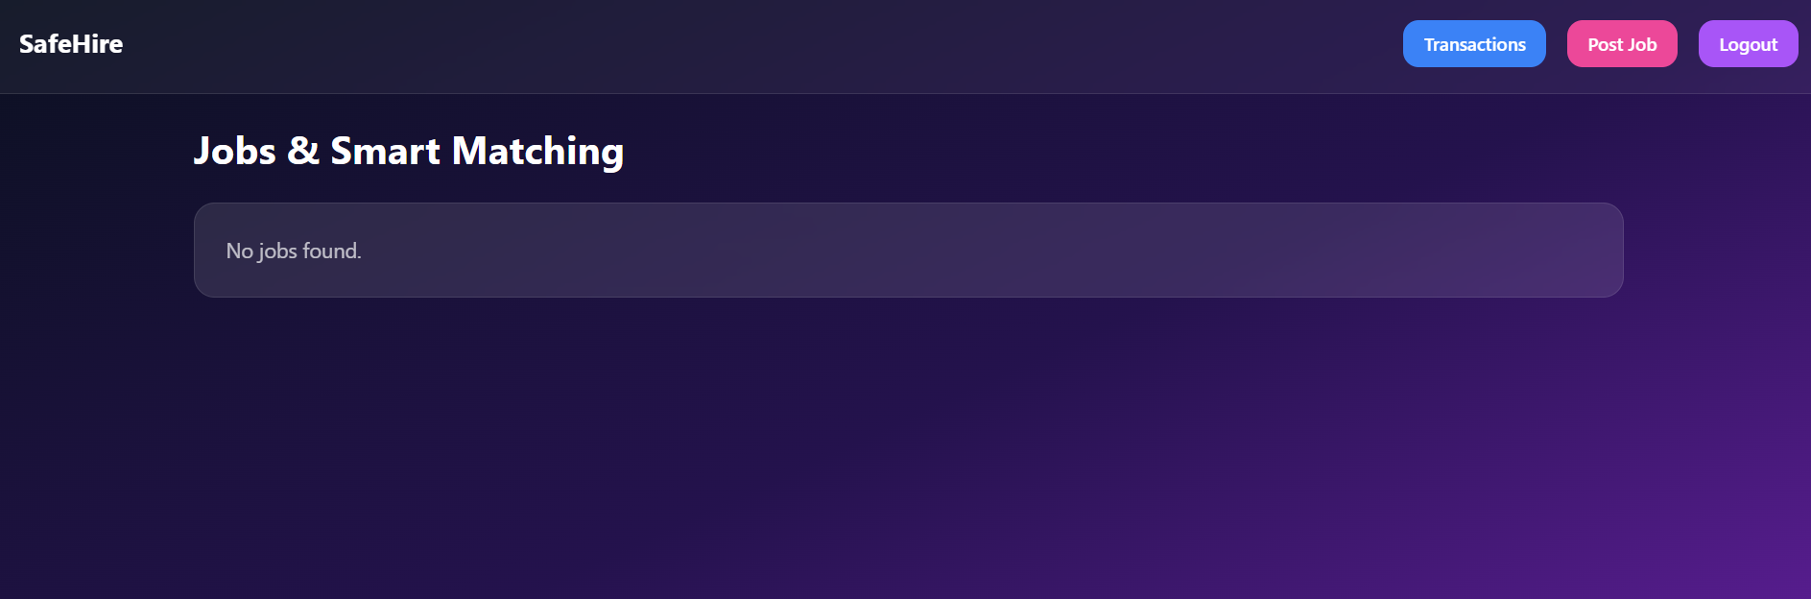
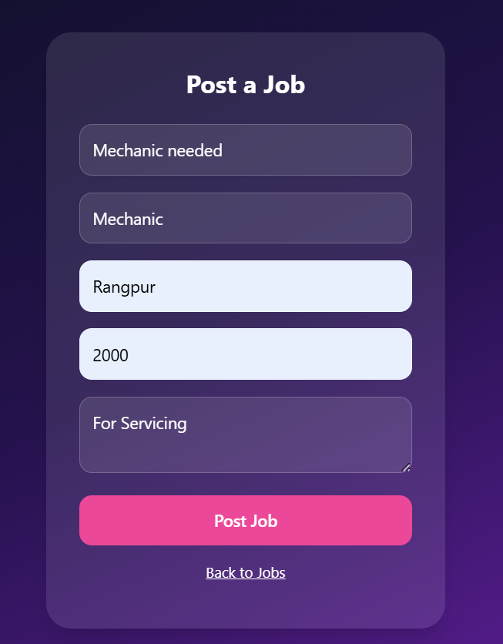
Stage 3 – Job Posting System
Employers can:
Post jobs
Define required skills
Jobs stored in database

Slide 11
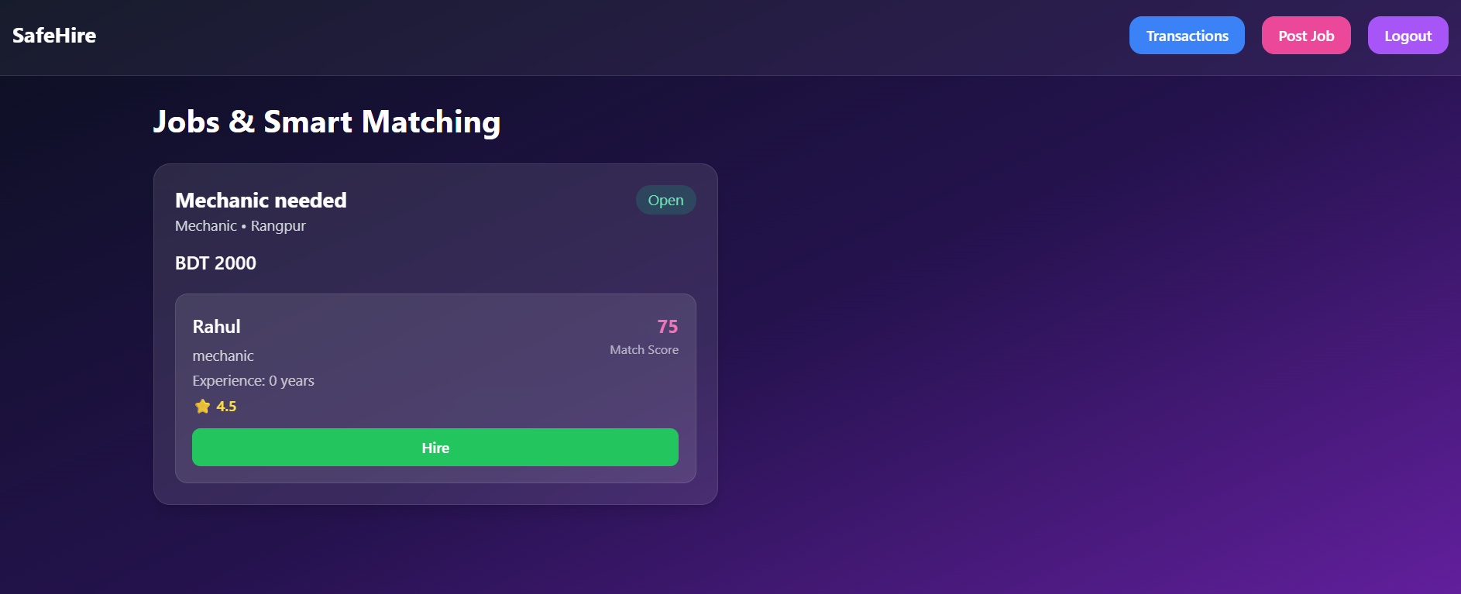
Stage 4 – AI-Based Job Matching
Matching system recommends workers based on:
Skills
Experience
Uses backend logic (AI placeholder)

Slide 12
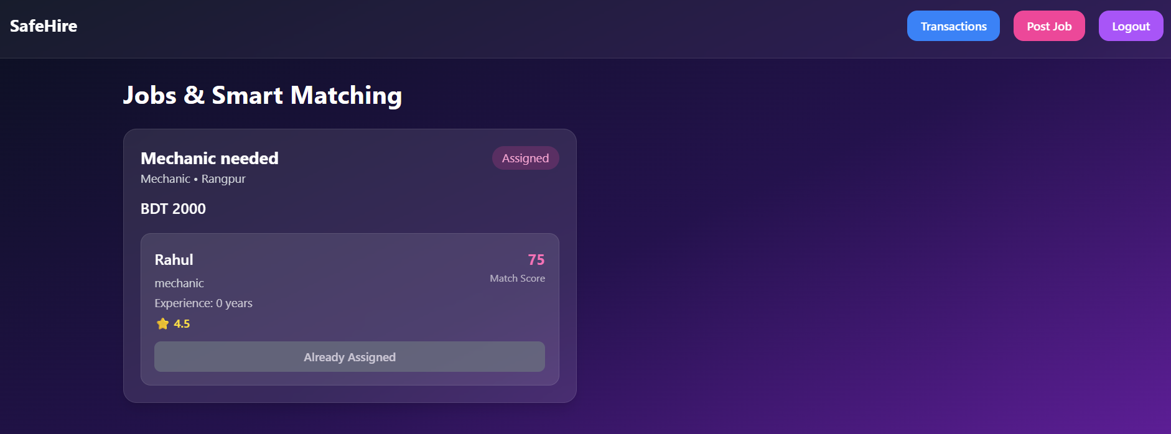
Stage 5 – Hiring Workflow
Employers can:
Select worker
Assign job
Job status changes: Hire → Assigned

Slide 13
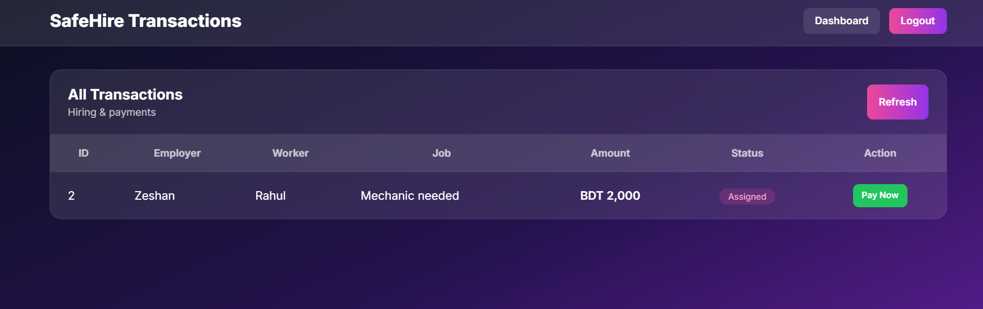
Stage 6 – Transaction System
Tracks:
Hiring records
Payment status
Transaction model implemented

Slide 14
Stage 7 – Payment Simulation
“Pay Now” button added
Status updated:
Assigned → Completed

Slide 15
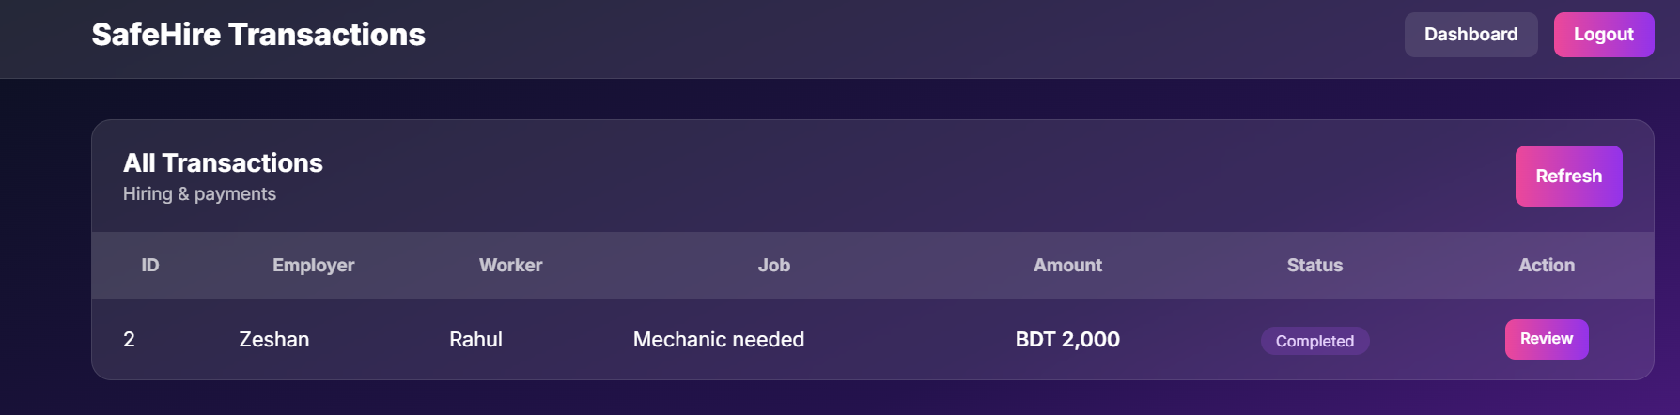
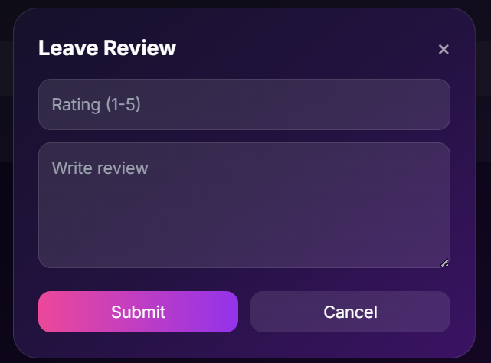
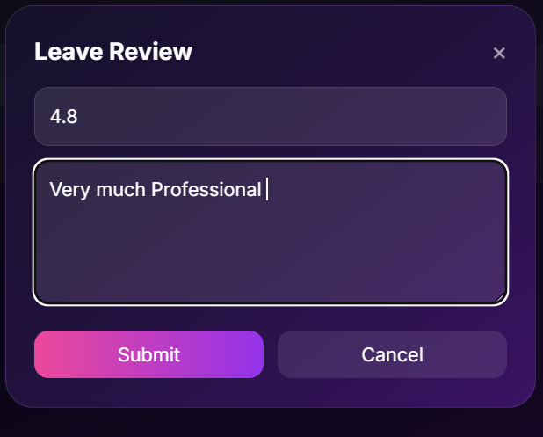
Review & Rating System
Employers can:
Rate workers
Give feedback
Builds worker credibility

Slide 16
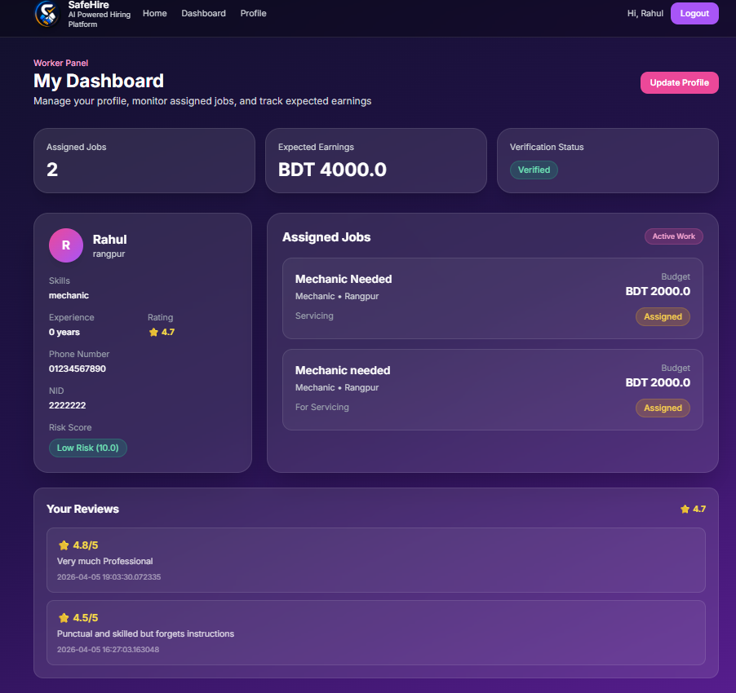
Worker Dashboard
Overview :
The Worker Dashboard provides a personalized interface where workers can manage their profile, view assigned jobs, track earnings, and monitor their performance.
Key Features:
Dashboard Summary Cards:
Displays total assigned jobs, expected earnings, and verification status.
Profile Information Panel:
Shows worker details including skills, experience, rating, phone number, and risk score.
Assigned Jobs Section:
Lists all active jobs with details such as job title, location, budget, and status
Reviews & Ratings System:
Displays feedback and ratings from employers to build credibility

Slide 17
Data Validation & Error Handling
Backend validation added:
Prevent invalid inputs
Duplicate prevention
User-friendly error messages

Slide 18
System Integration & Testing
All modules integrated:
Registration
Verification
Matching
Hiring
Payment
End-to-end workflow tested

Slide 19
Tools & Technologies Used
Frontend :
HTML, CSS
Tailwind CSS → UI design
JavaScript → Dynamic interaction
Backend:
Python (Flask)
Routing & API handling
Database:
SQLite (SQLAlchemy ORM)
AI Logic:
Matching algorithm (custom logic)
Development Tools:
VS Code
Git & GitHub
Project Architecture :
Frontend → UI (HTML, Tailwind) Backend → Flask routes
Database → SQLite Matching Module → Services layer

Slide 20
Conclusion
SafeHire successfully developed as a complete hiring workflow system
Ensures:
Worker trust
Efficient hiring
Structured transactions

